Slide 1
Hands On Machine Learning With Python
BY Muhammad Arslan Shahzad @ Icodeguru

Slide 2
Machine Learning
Machine Learning as a term introduced by Arthur Samuel in 1959:
“Machine Learning enables a machine to automatically learn from data, improve performance from experiences and predict things without being explicitly programmed.
Machine Learning is the subfield of AI concerned with the algorithm capable of learning from past data and predicting output on new data, by imitating the human intelligence/learning.

Slide 3
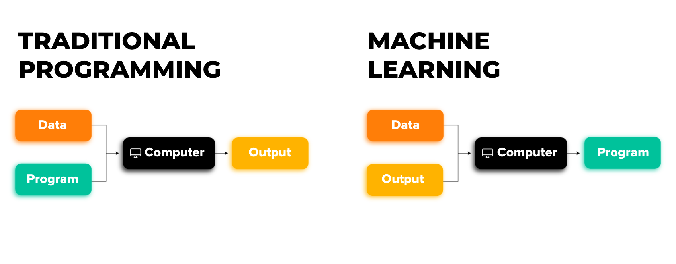
ML v/s Traditional Dev

Slide 4

Application of Artificial Intelligence ???

Slide 5
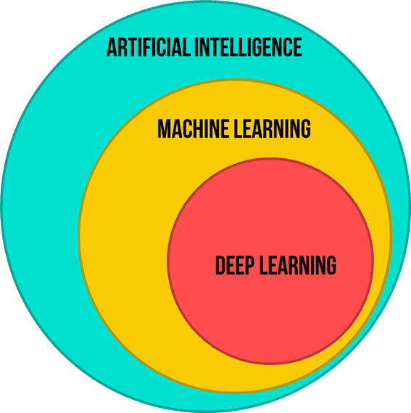
AI vs ML

Slide 6
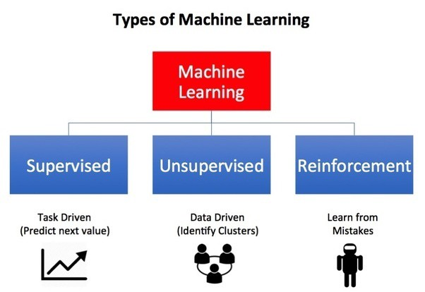
Types of Machine Learning

Slide 7
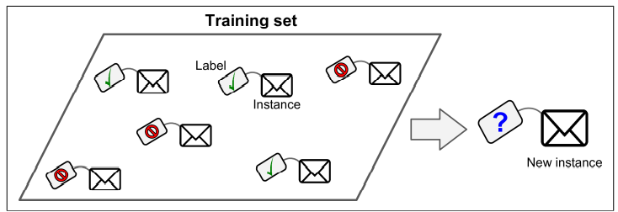
Supervised Learning
In Supervised Learning we feed labeled data to algorithm, from which the algorithm learns and predict the new outcomes.

Slide 8
Types of Supervised Learning
Two types of Supervised Learning are:
Classification
Regression

Slide 9
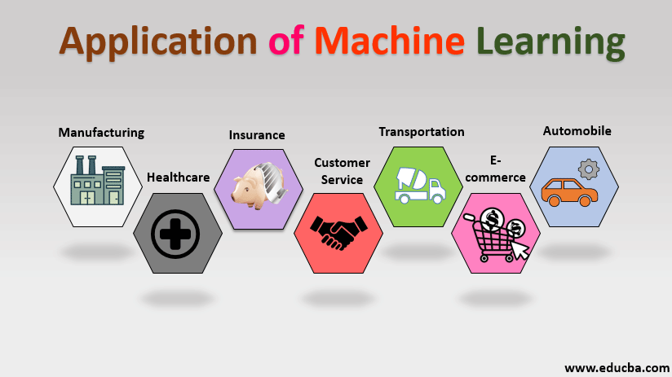
Applications of Supervised Learning?

Slide 10
ML Life Cycle (Steps of ML)
Gathering data
EDA (Exploratory Data Analysis)
Data Preparation
Model Development
Model Selection
Training Model
Evaluation of Model
Model Tuning
Model Deployment

Slide 11
Gathering Data
Every ML problem required a data
ML learns from given data to predict on the unknown data
Make sure data from a reliable source as it affect the outcome directly
Try your data should not have much missing or repeated values

Slide 12
EDA
Before performing anything on the data we need to get the insights of the data.
What our data is all about
EDA is all about making sense of data in hand.

Slide 13
Data Preparation
Putting together all the data you have an randomizing it
Cleaning the data to remove unwanted data
Visualizing the data to understand how it structed and related to each other
Splitting the cleaned data in to two set (training and testing)

Slide 14
Model Development
Choosing Model
It is important to choose a model that is related to problem
Also need to see if model is suited for numerical or categorical data and choose your model accordingly
Training your model on the prepared data you have and finding patterns to make predictions.

Slide 15
Cont.
Evaluating the model
After training your model you have to evaluate how your model is performing.
By giving the new/ testing dataset to model which is previously unseen for it.
And this way performance of the model can be calculated.
Accuracy score
Confusion Matrix
F1 Score
Precision

Slide 16
Model Tuning
Once model is created and evaluated see if the accuracy can be improved in any way.
This is done by tuning the parameters present in your model
Parameters are the variables in your model that the programmer generally decided

Slide 17
Model Deployment
After creating model and evaluating it
We need to deploy it on some cloud service
So we can access it and use it in our app, or make it available to public

